Slide 1
Emergency Management Drills
What are they?
Why do we do them?
What should we expect from each other?
Published: May 2024

Slide 2
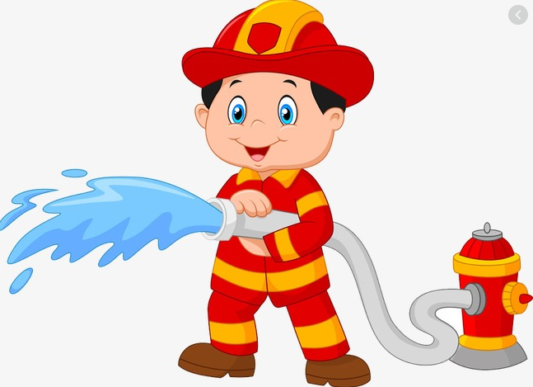
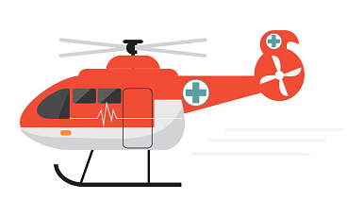
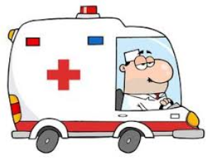
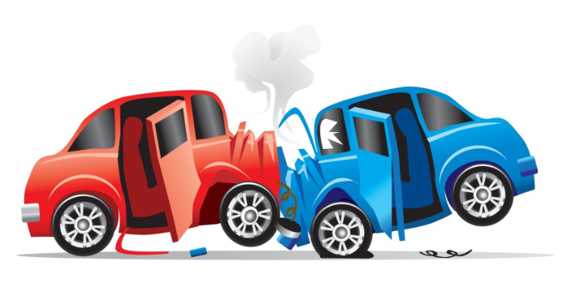
Emergencies in schools
Every school in Victoria (in fact Australia) is expected to practise preparing for an “emergency”.
When we hear the word “emergency” it can conjure up lots of images and thoughts? It’s important that we all have a good understanding of what we mean when we use the word “emergency”.
What types of emergencies can you think of that could affect our school?

Slide 3
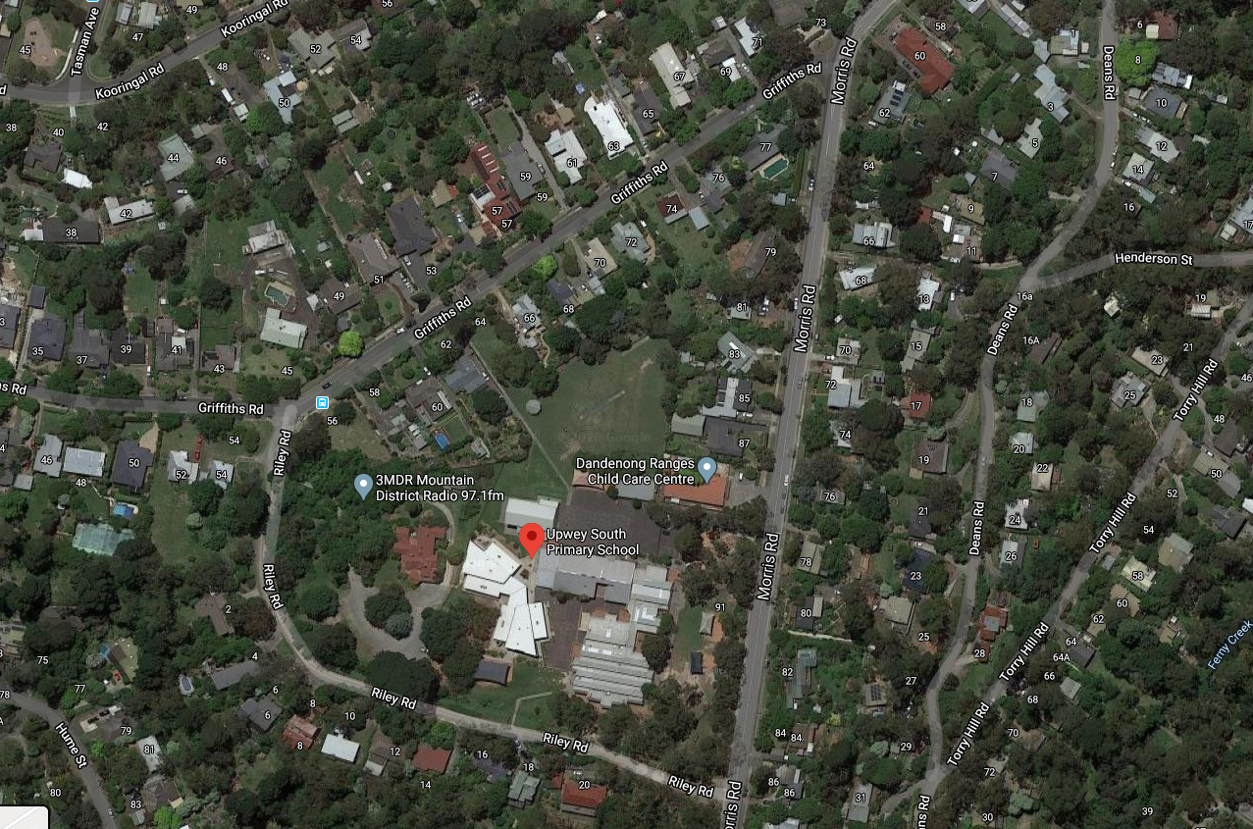
What types of emergencies do we prepare for?
Emergencies in schools can occur naturally, (such as weather-related events) or can occur due to human action (such as a vehicle accident).
The impact of these emergencies can also vary; impacting at an immediate school level, neighbourhood level, local area level, or even state level.
Some emergencies can impact on
just our school
OR
the surrounding neighbourhood.

Slide 4
Why do we need to practise?
Depending on the type of emergency, we may need to:
evacuate to the gymnasium (or the oval)
OR
stay inside a certain building.
When we practise moving to the gymnasium or the oval, this is called an “evacuation”
Evacuation just means that we have to leave the building we are in, and move to a safe space (this might be due to a leaking roof, a fire, etc).
When we practise staying inside our classrooms, this is called a “lockdown”.
Lockdown just means we need to stay inside our classrooms, as there is something outside which could be unsafe (such as a swarm of wasps, fallen trees, etc)

Slide 5
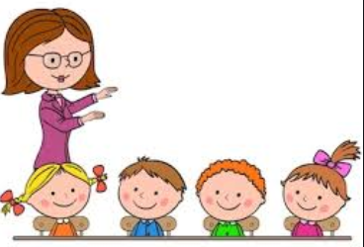
Why do we need to practise?
The more we practise, the more confident we become.
The most important thing to remember is:
Listen respectfully to the instructions of your teacher.

Slide 6
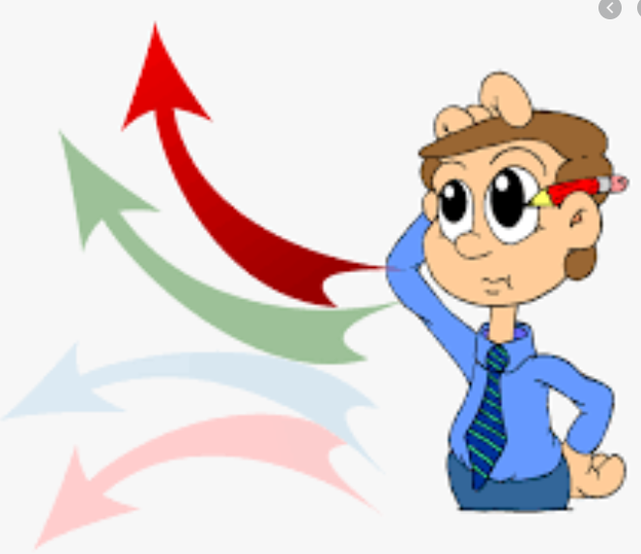
What should we expect from each other?
We will hear a siren sound over the
loudspeaker which makes a “whoop, whoop” noise.
When we hear this noise we should
stop what we are doing, and listen carefully.
Whenever there is an emergency,
the teachers will know exactly what to do.

Slide 7
What should we expect from each other?
After the siren sound, there might be an
announcement on the loudspeaker,
or the classroom telephone might ring.
We should stop what we are doing
and listen carefully.
The teachers will tell us what we need to do.
Sometimes there will be no announcement, and the teachers will be communicating via our internal phone system.

Slide 8
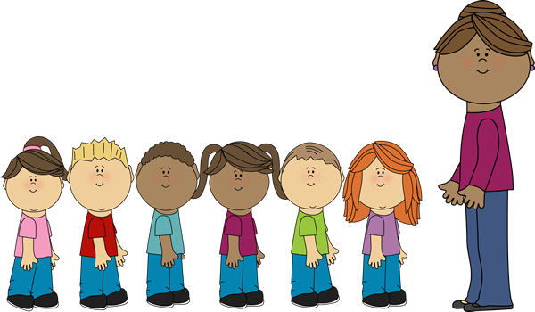
What should we expect from each other?
In an “evacuation” we will:
Listen to our teacher.
Line-up in an orderly manner and move
to the evacuation point (gymnasium or oval).
When we line-up, our teacher will tell us if we need to bring anything.
Otherwise, our bags and other things will stay in the classroom.

Slide 9
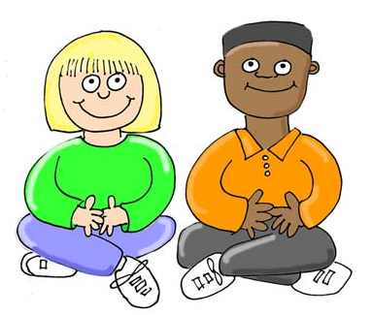
What should we expect from each other?
In an “evacuation”:
When we get to the evacuation point we will
sit down in a single line with our class.
All of the other classes will be there, and they
will sit in a single line as well.
It is important that we sit respectfully, so that the teachers can provide us with instructions.

Slide 10
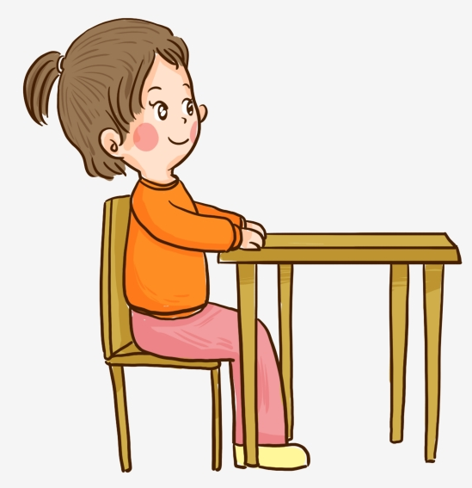
What should we expect from each other?
In a “lockdown” we will:
Listen to our teacher.
Stay inside the classroom.
Continue with our learning.
It is important that we continue to learn quietly and respectfully, so that the teachers can provide us with instructions.

Slide 11
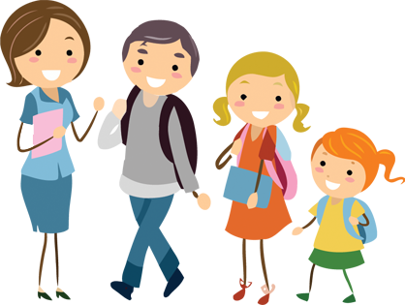
What happens after the emergency?
After the emergency has been declared “safe”, we will be told if we can move back to our classrooms.
When we get back to our classrooms, we will continue with our learning.
Our parents/ carers will be sent a note on Compass, telling them that we
practised an emergency drill.
When we get home, we can tell our parents about what we did and how we are acting to keep safe in an emergency.

